Slide 1
Project update
Group 16

Slide 2
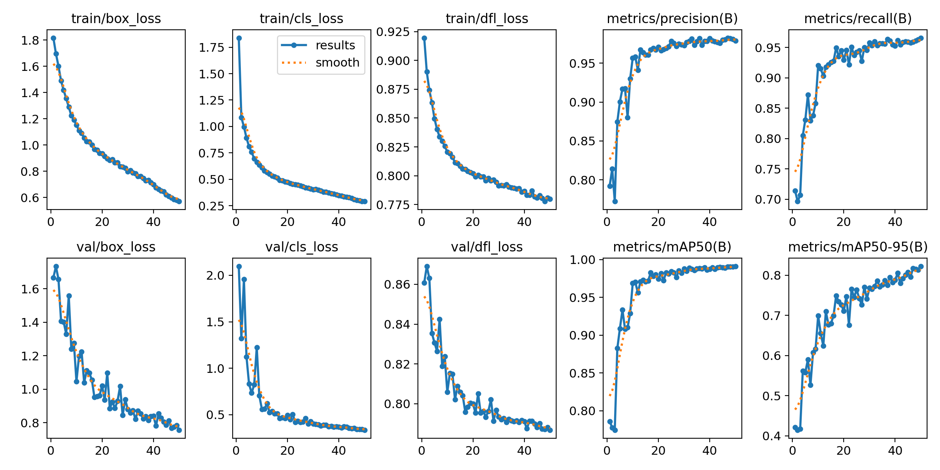
Results

Slide 3
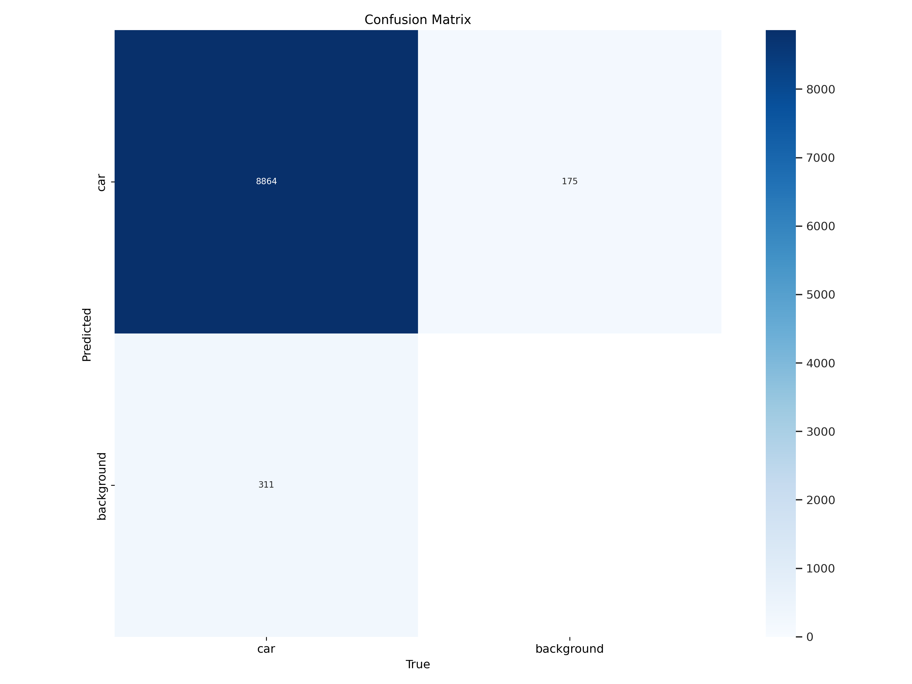
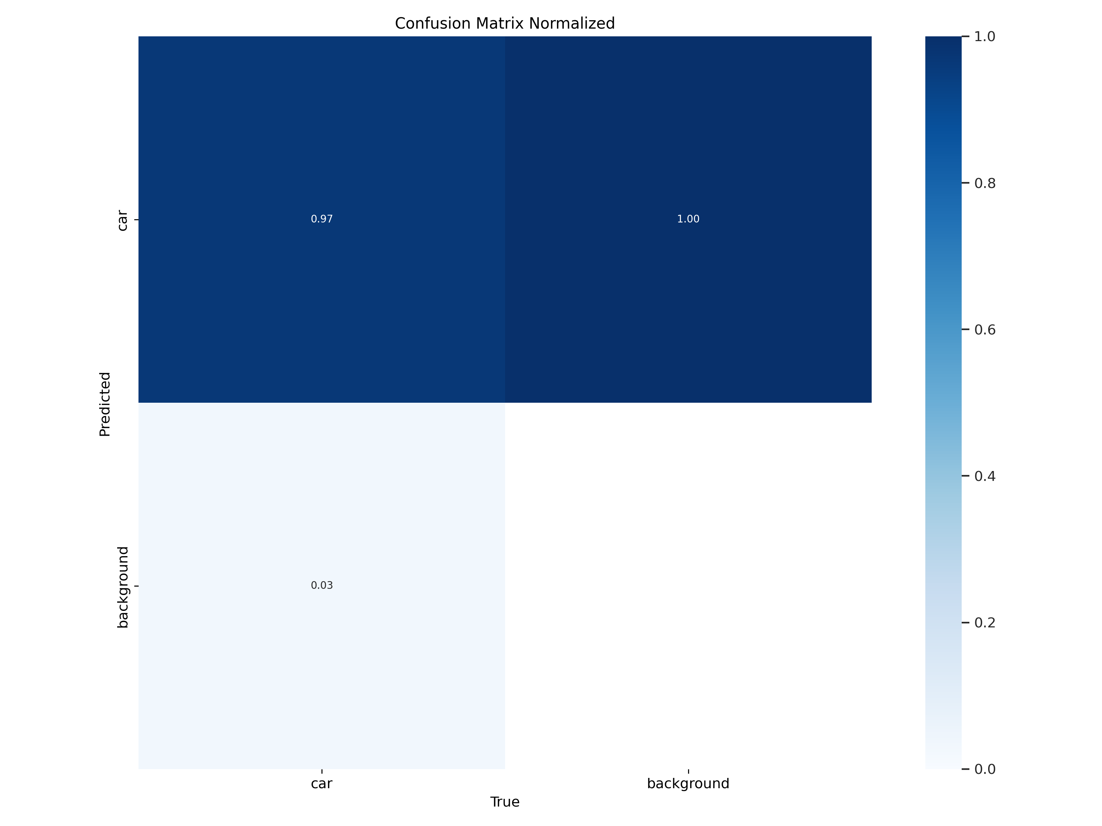
Confusion matrix

Slide 4
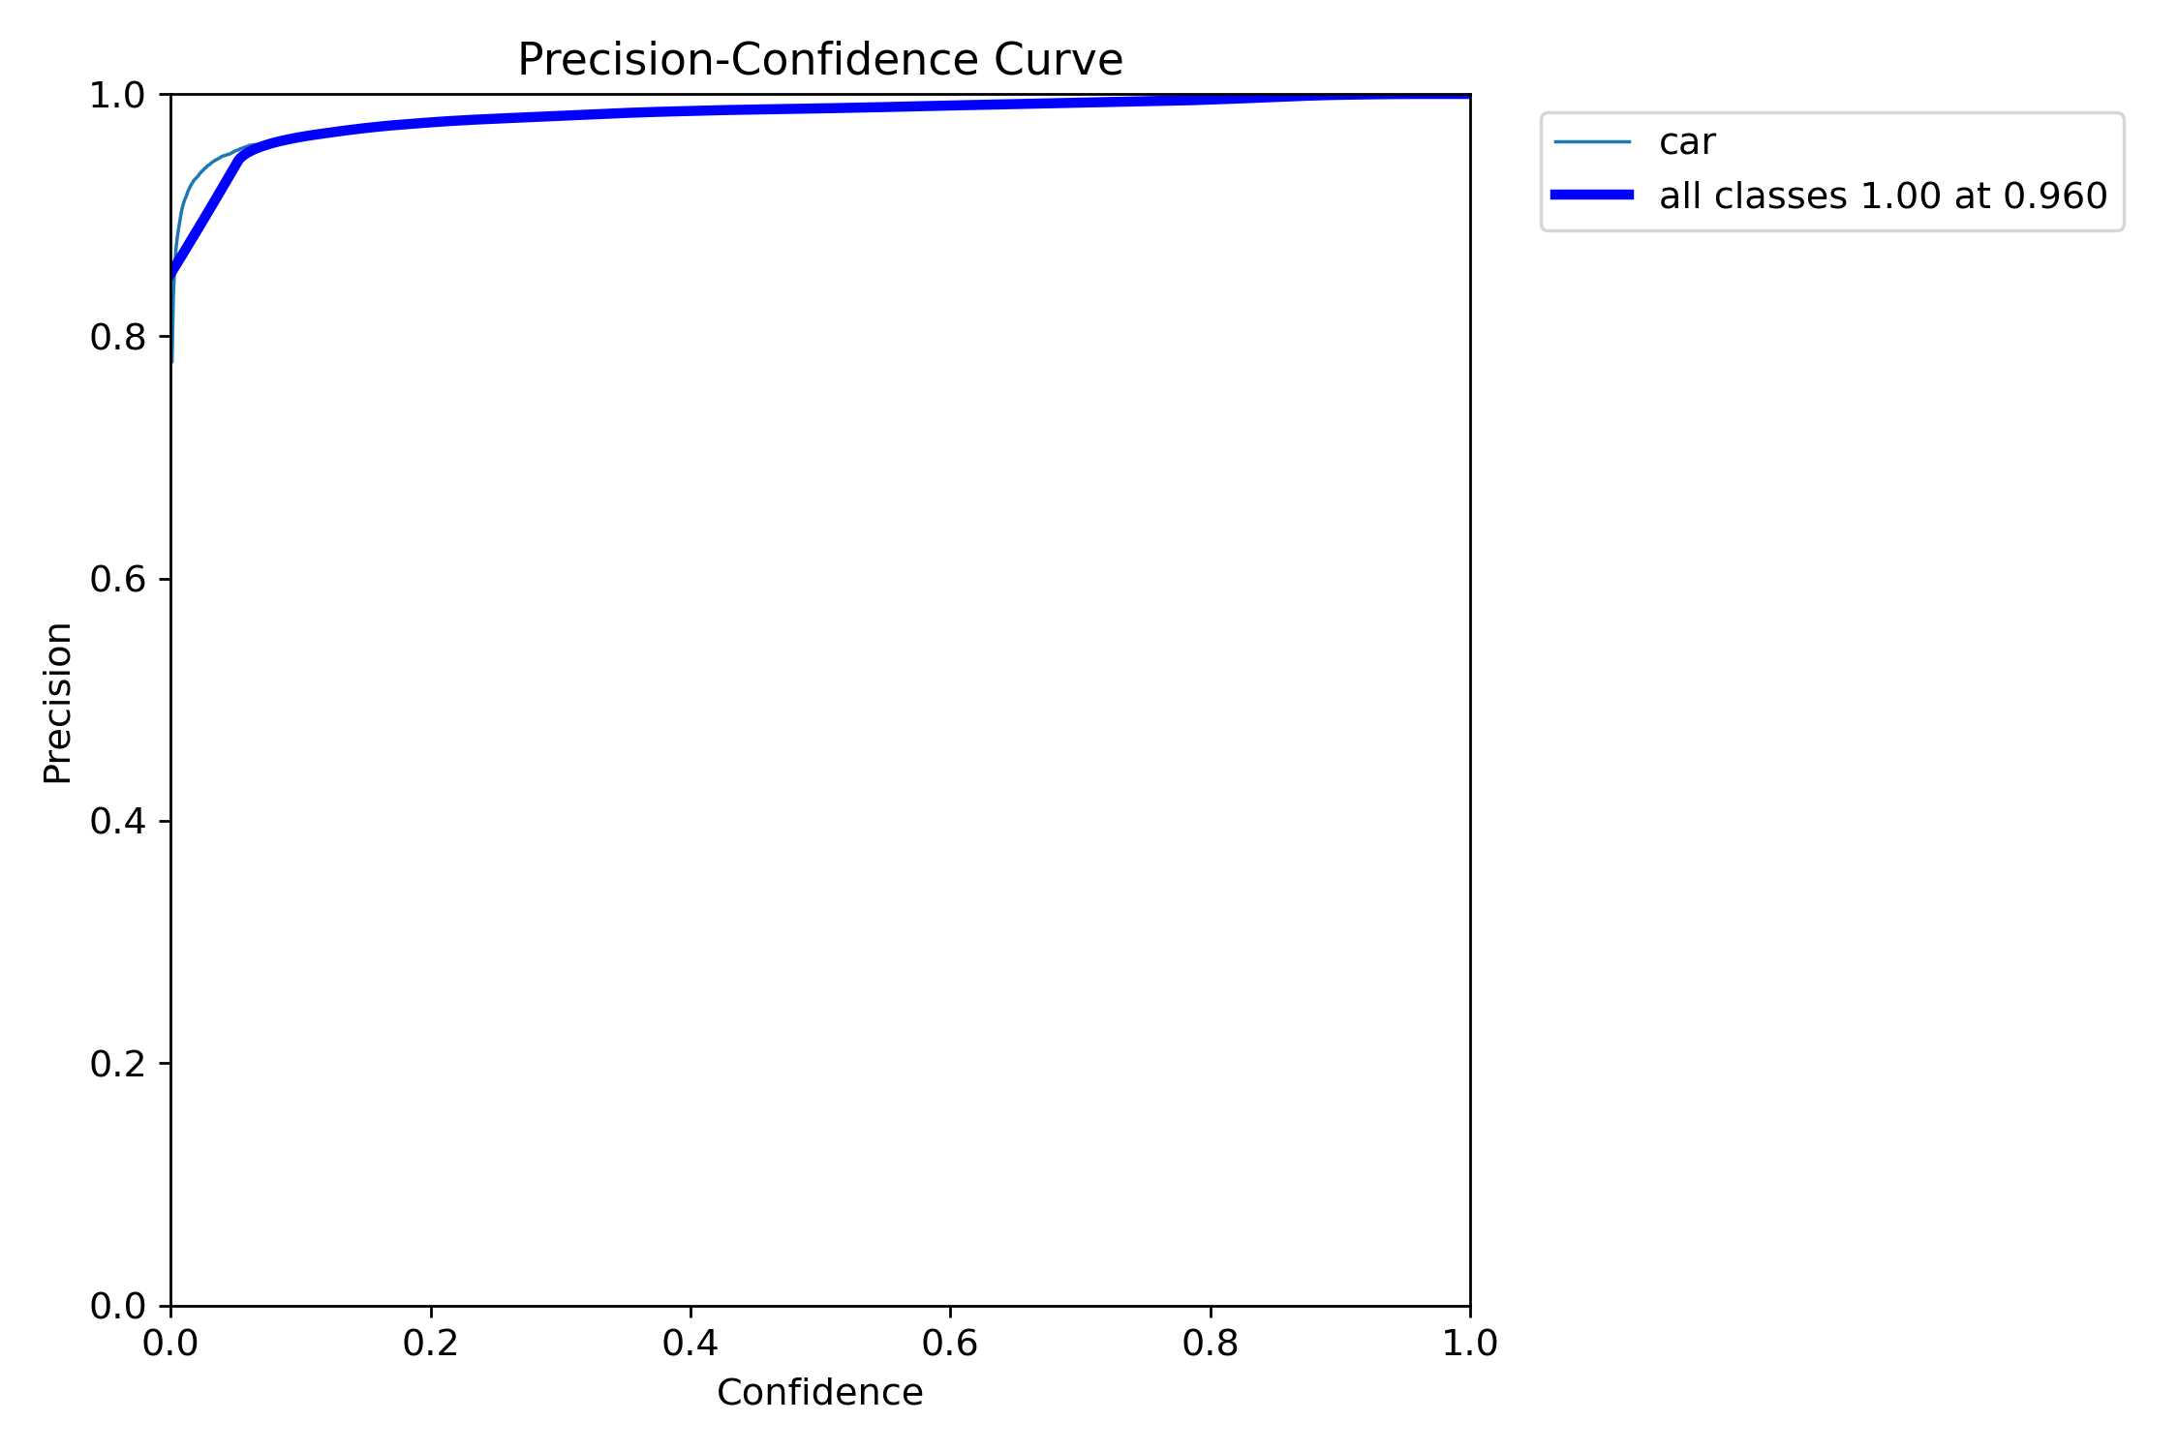
Precision curve

Slide 5
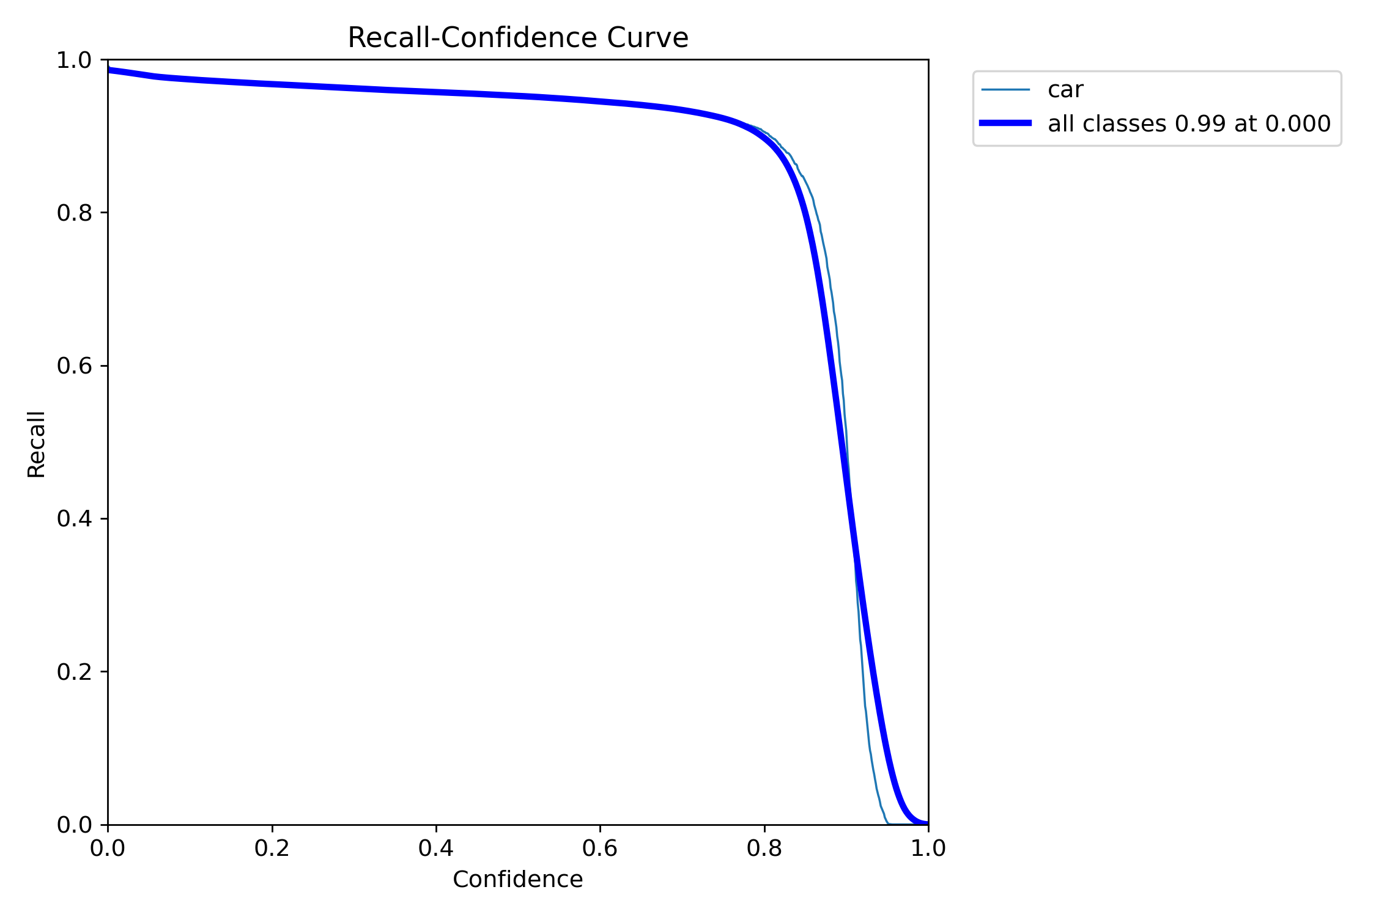
Recall curve

Slide 6
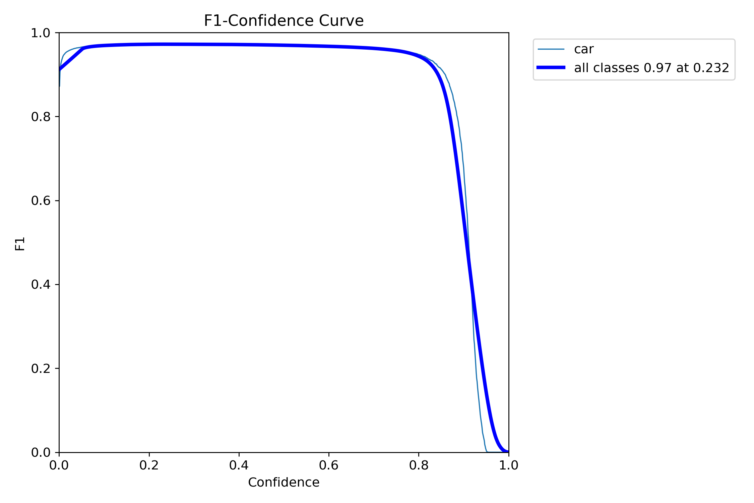
F1-Score Curve

Slide 7
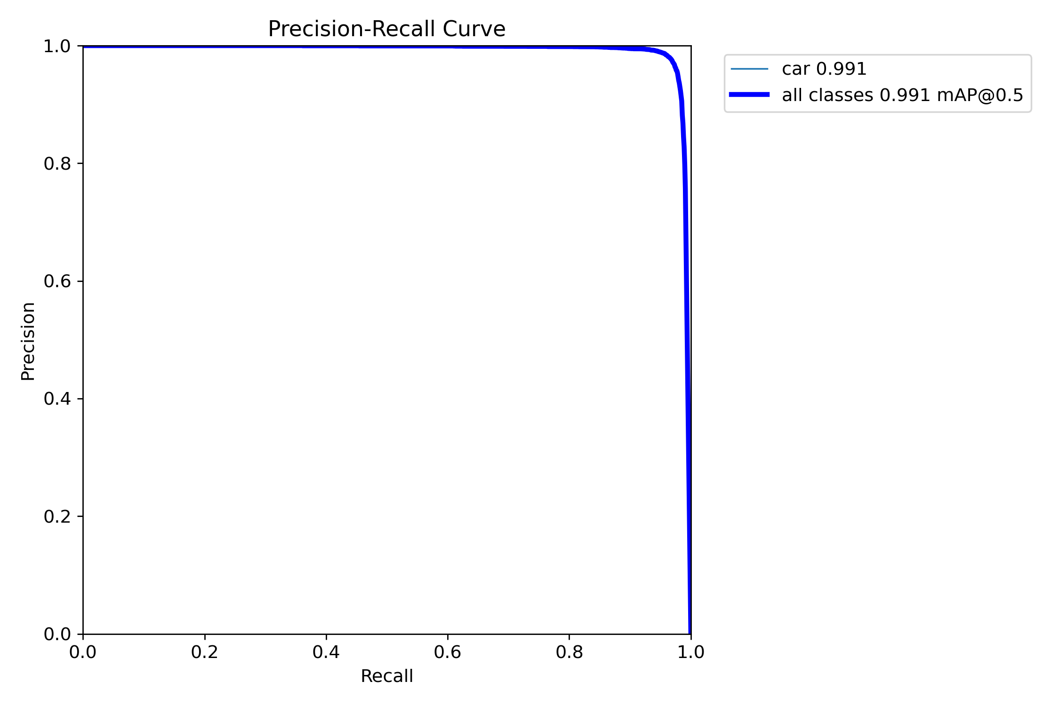
Precision-Recall Curve

Slide 8
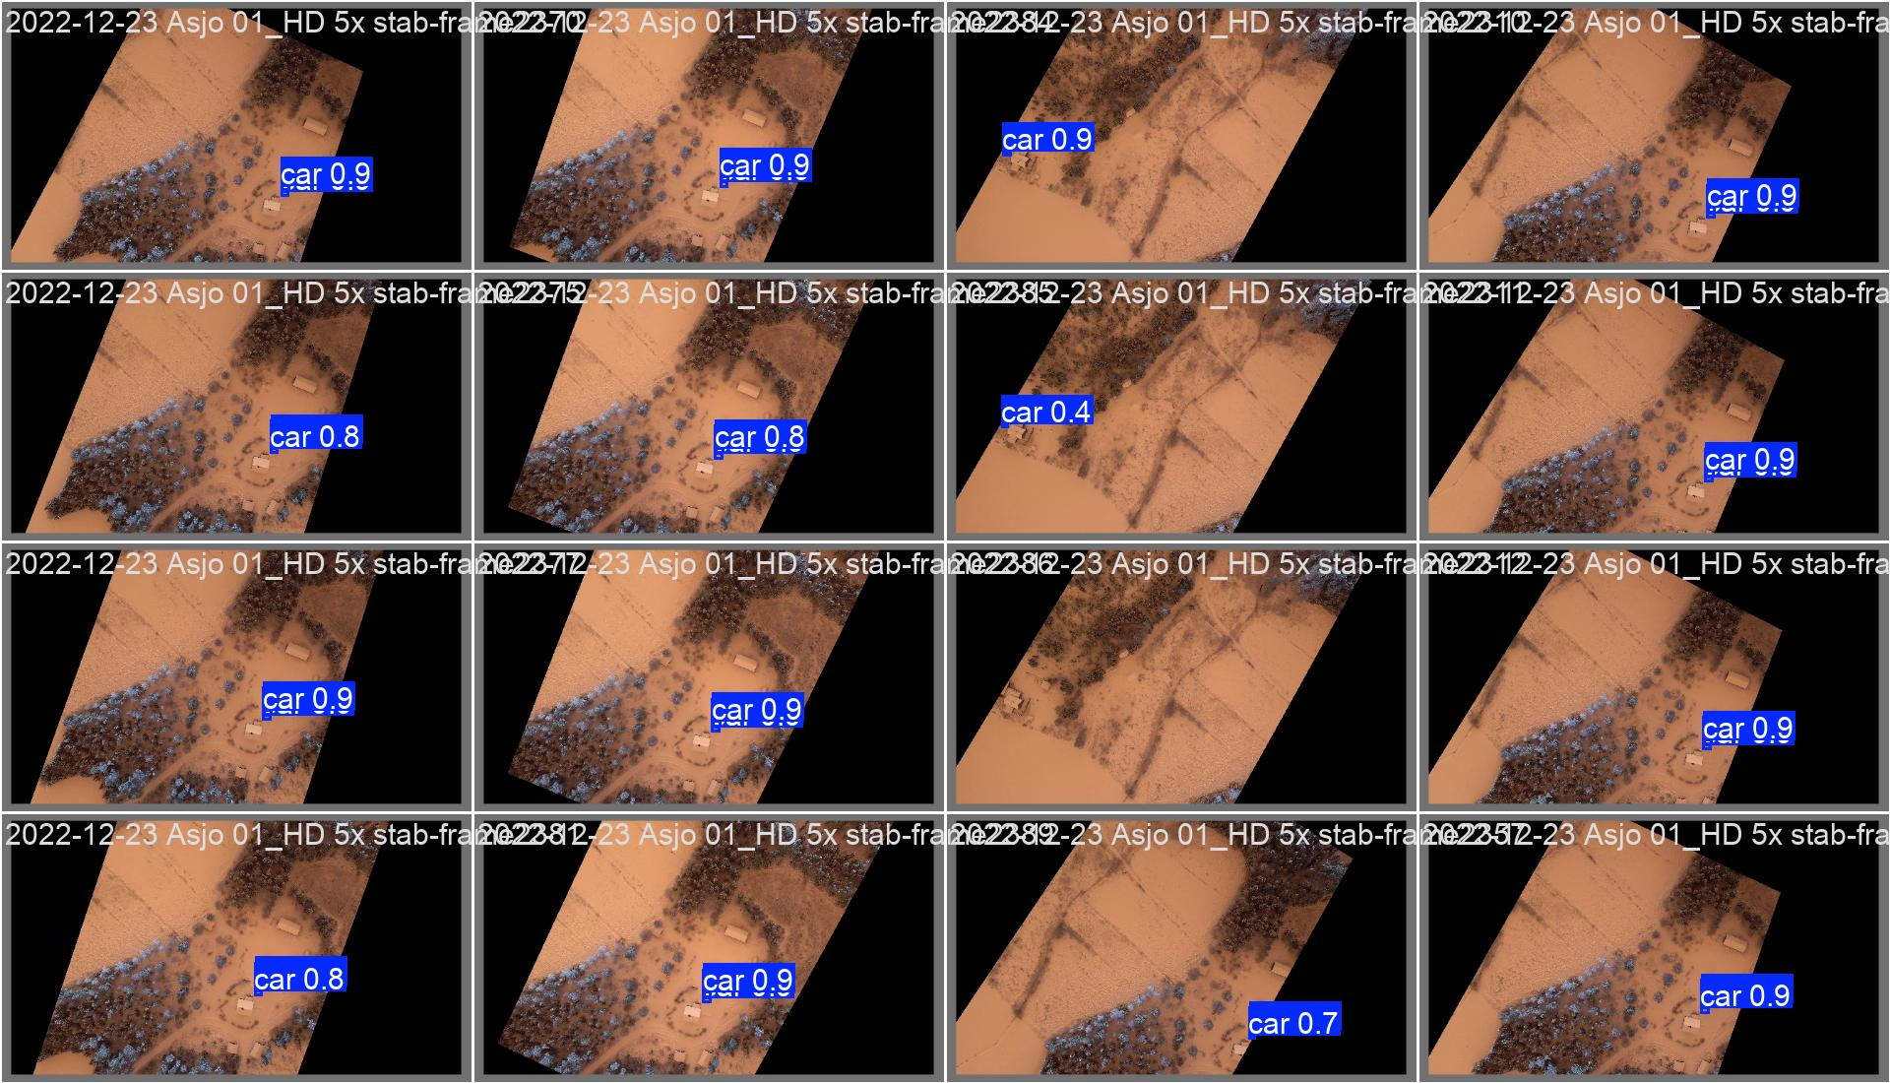
Validation batch 0

Slide 9
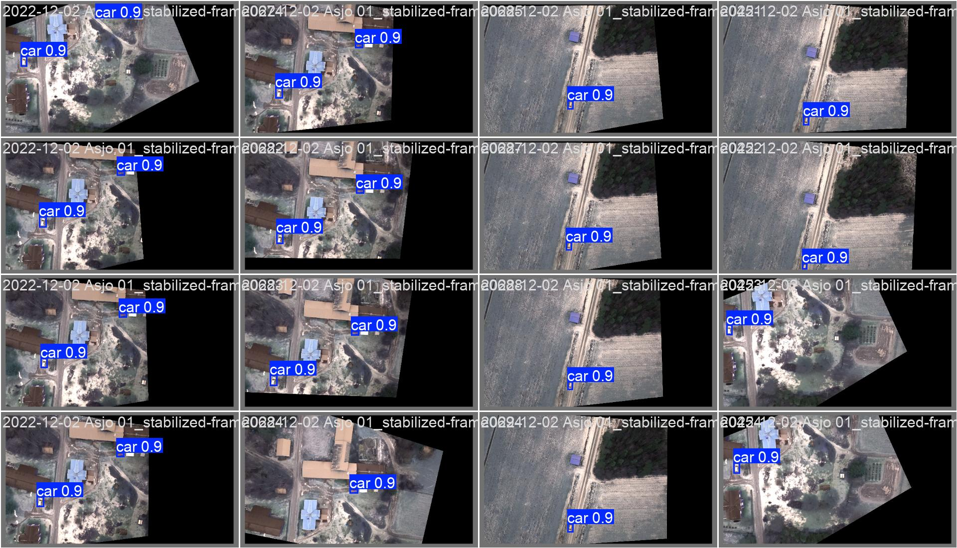
Validation batch 1

Slide 10
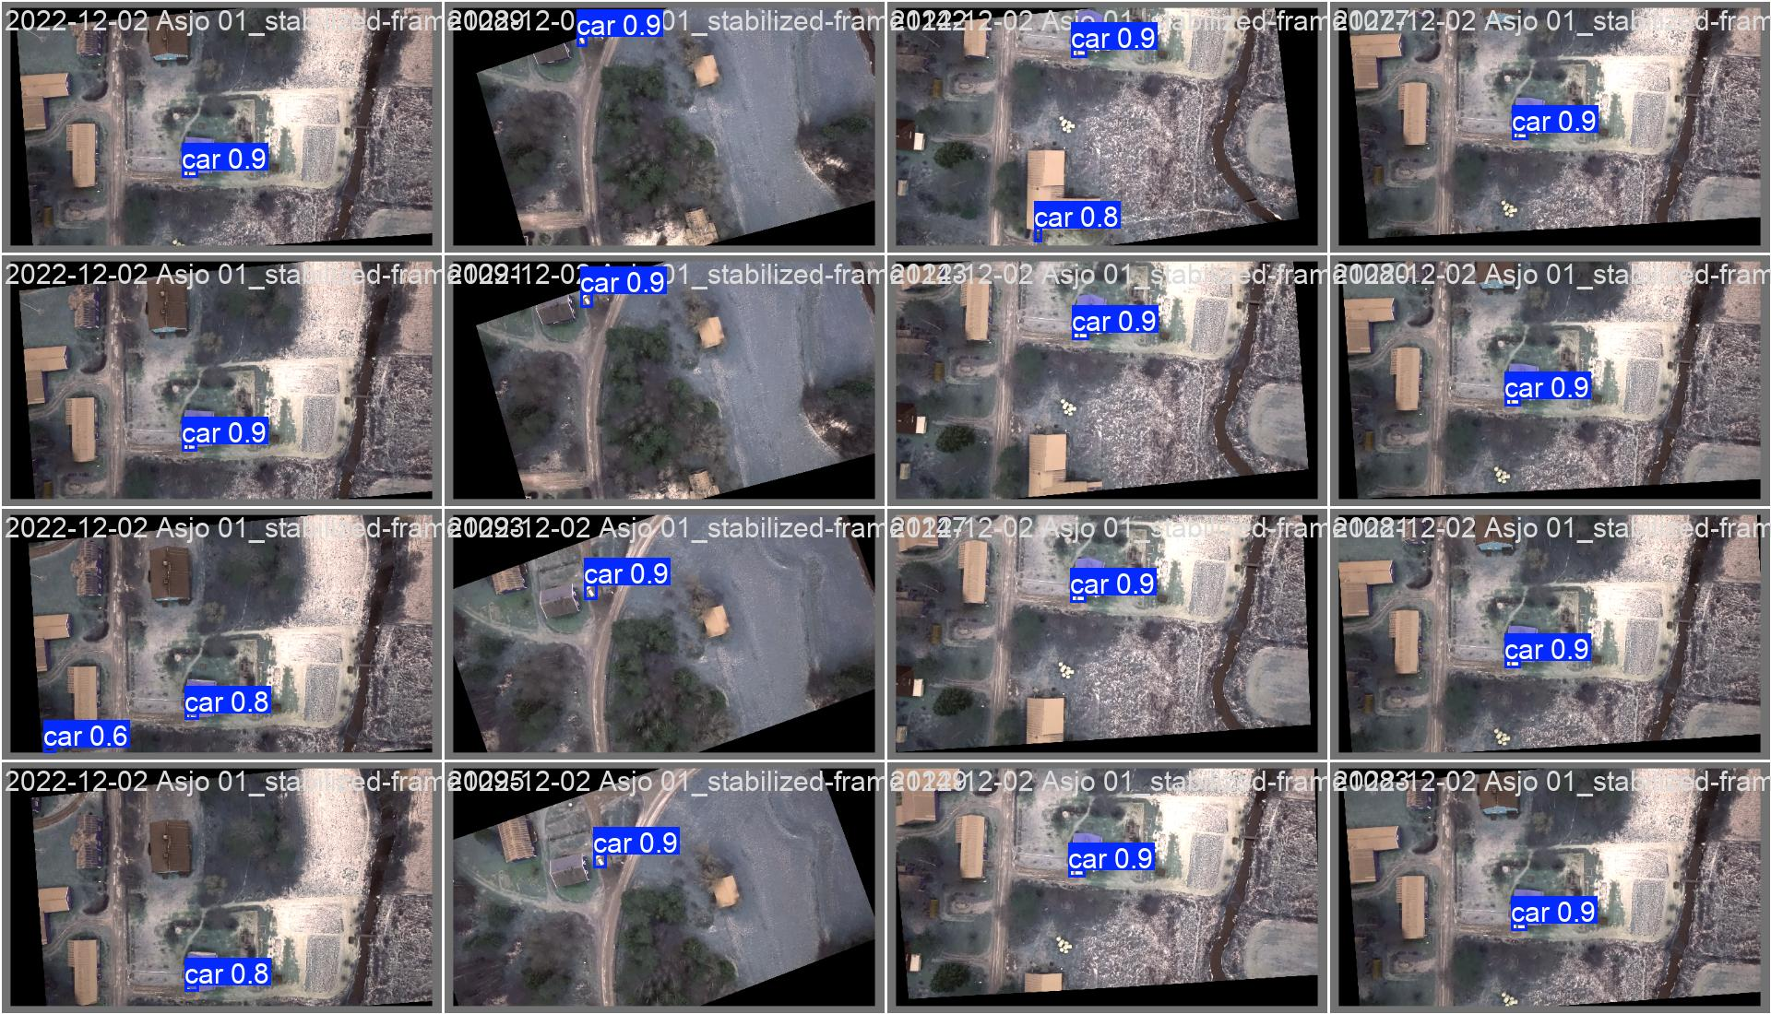
Validation batch 2

Slide 11
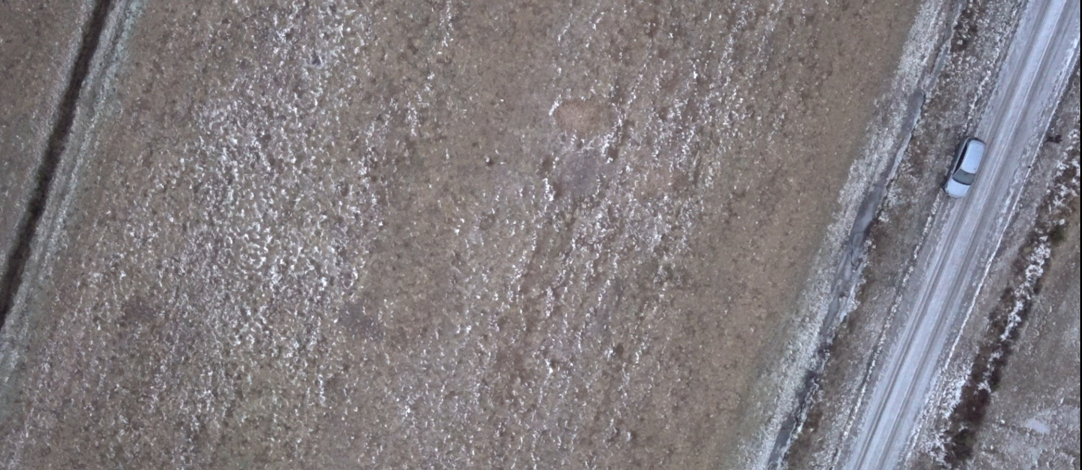
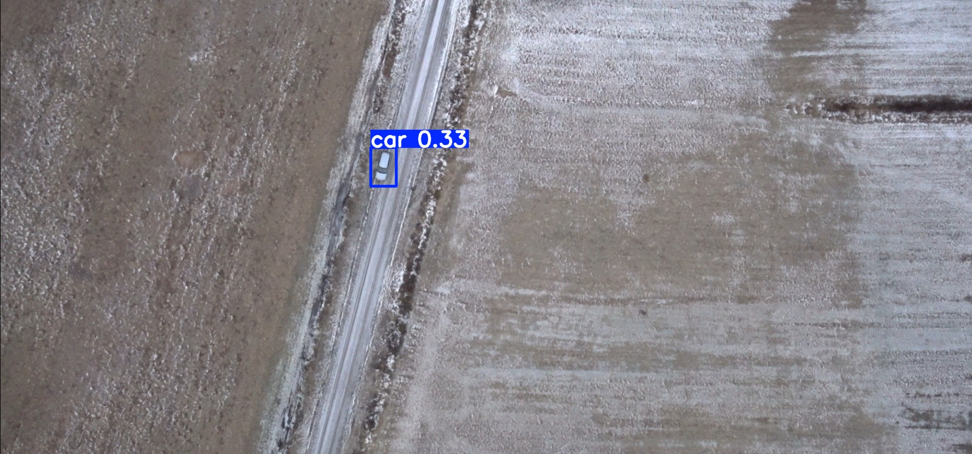
Comparison of the original aerial image (left) and the YOLOv9c detection result (right), highlighting successful identification of a vehicle in snowy conditions despite low confidence of 0.33

